Slide 1
Online T&E Reimbursement Instructions

Slide 2
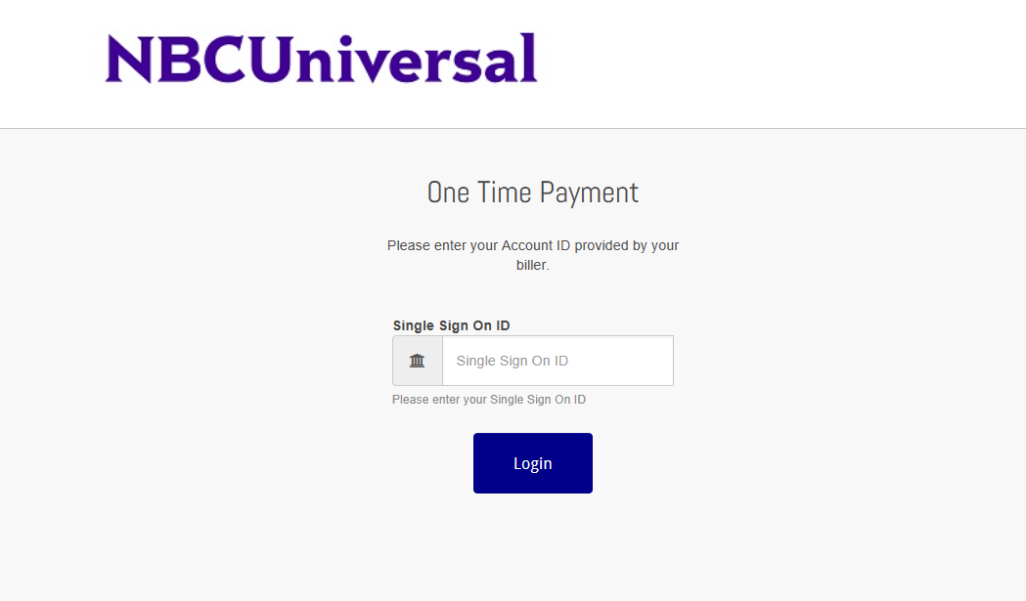
Logging In
Go to link
You will log-in using your SSO
Enter SSO here

Slide 3
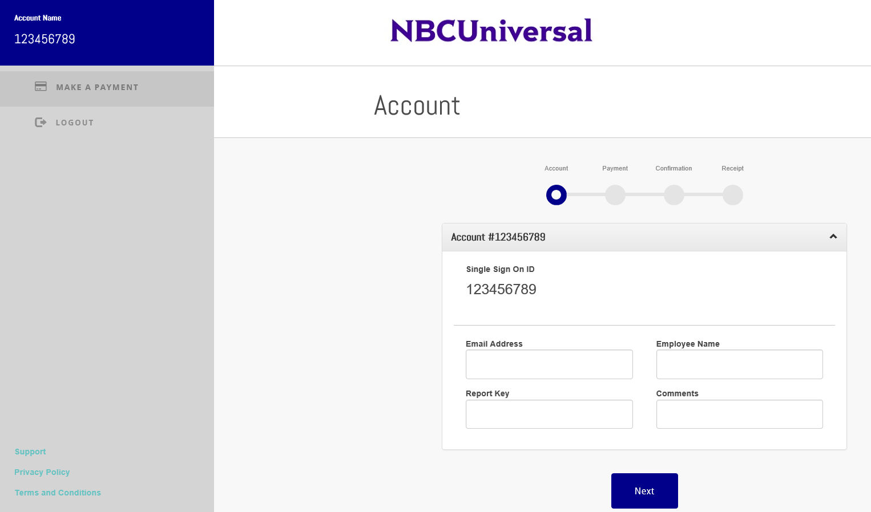
Account Information
Once you are logged in, you will be brought to this page
You will need to enter
  Your email address
  Your name
  The report key related to the payment you are making
  Any comments that you have about the payment

Slide 4
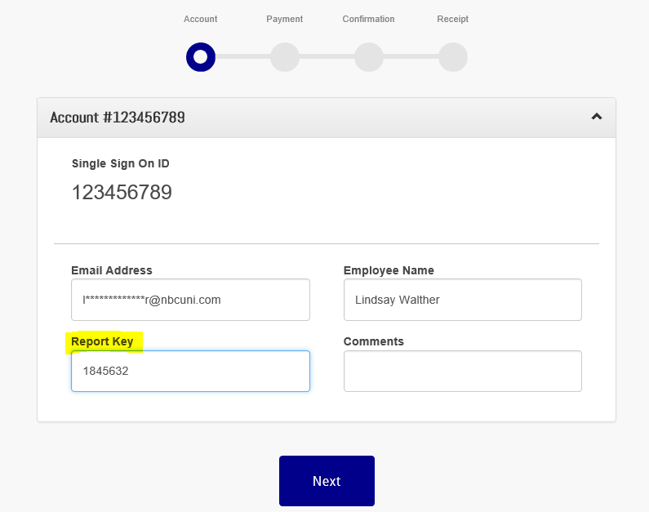
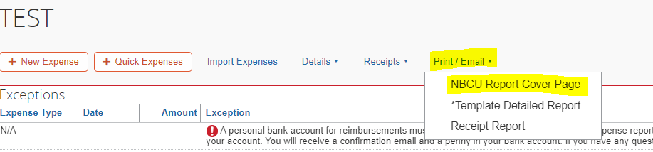
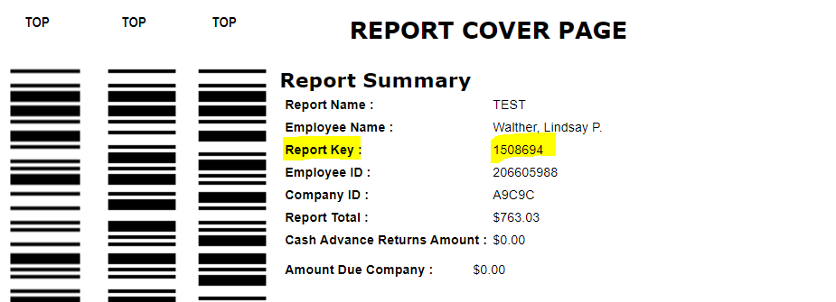
Account Information – Report Cover Page
To find the report cover page, you will need to go to the expense report that you submitted the personal expense on.
  You will then go into Concur, click on the report with the charge, select Print/Email
  You will then click on the NBCU Report Cover Page
  Take note of the Report Key

Slide 5
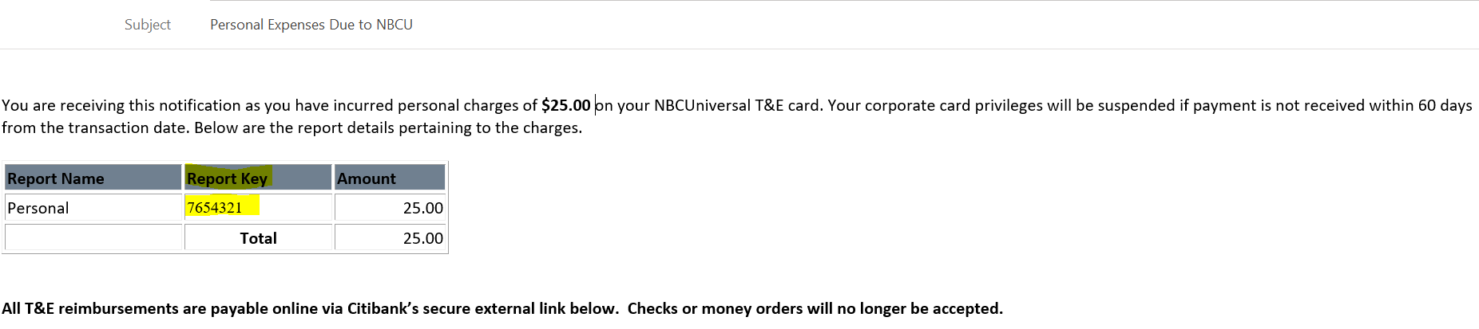
Account Information – Report Cover Page
  You can also find the report key on the Personal Receivables email that is sent you weekly by the T&E Team

Slide 6
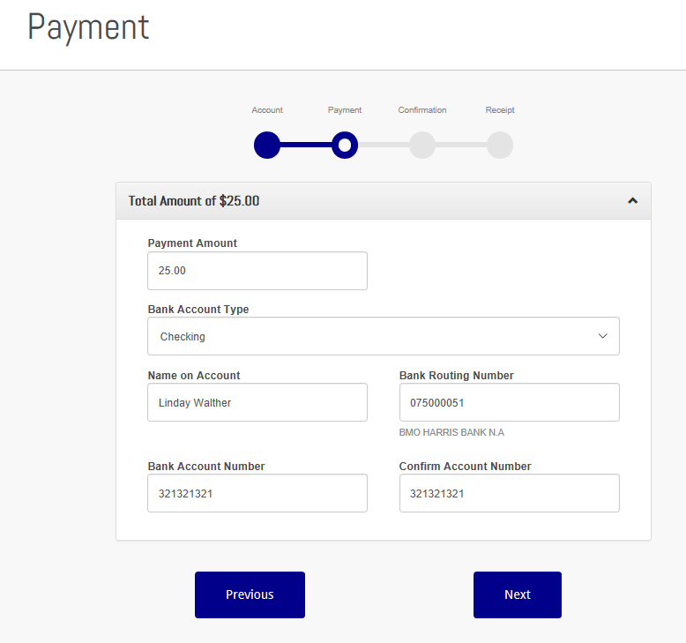
Payment Information
After you enter your account information, you will be need to enter your payment information. This includes
  Payment Amount
  Bank Account Type
    Checking
    Savings
    Business checking
  Name on Account
  Bank Routing Number
  Bank Account Number

Slide 7
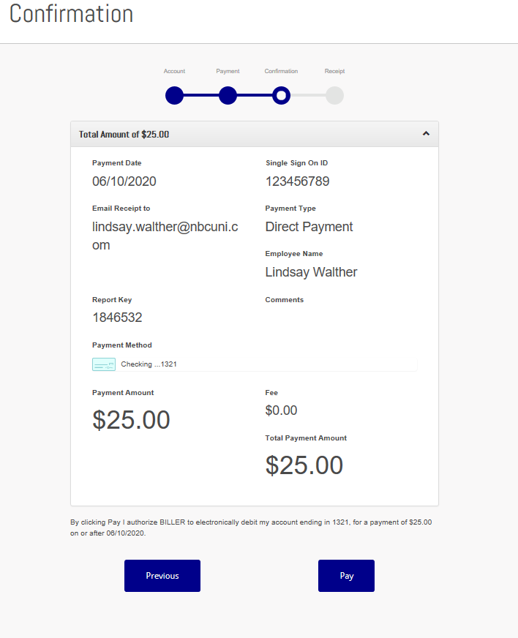
Confirmation
You will then be asked to confirm all the information that you input
Please confirm that everything is correct and then press Pay

Slide 8
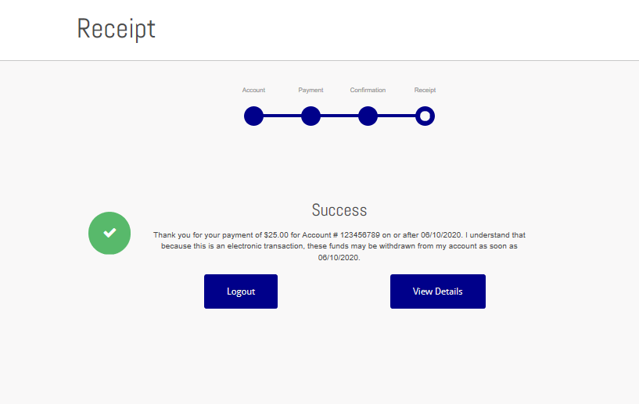
Receipt
You will then be brought to this screen where it will tell you if your payment was successful or not
  If you payment was not successful, you will receive an error message
You can view the details of your payment by pressing View Details
  You will then see all of the details of your transaction and can print it out for your reference
Shorty after you make your payment, you will receive a confirmation email as well

